Slide 1

Chapter 6
Analysis of Sequential Systems

Slide 2
Sequential Systems
Moore Model
  output (z) depends on current state only
Mealy Model
  output (z) depends on the current state and the input
State Tables
State Graphs

Slide 3
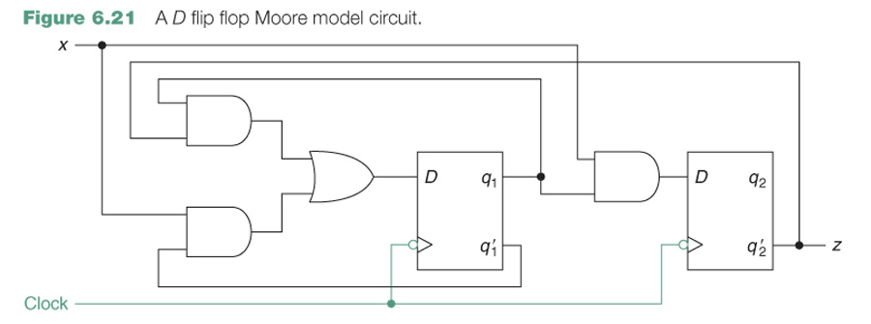
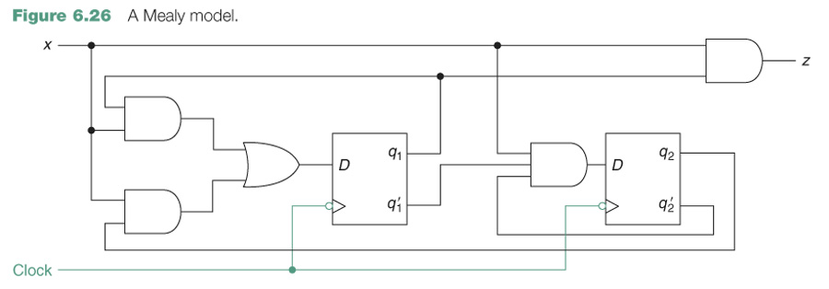
Moore Model - output (z) depends on current state only
Mealy Model - output (z) depends on the current state and the input

Slide 4
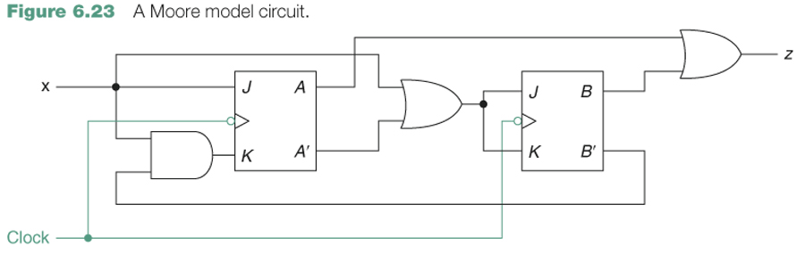
Moore Model - output (z) depends on current state only
Mealy Model - output (z) depends on the current state and the input
Which is it?

Slide 5
Flip-Flops
Made from logic gates with feedback loops
Used for sequential and non-sequential systems
A clock is used to determine the state-rate
Flavors:
  RS
  D
  JK
  T

Slide 6
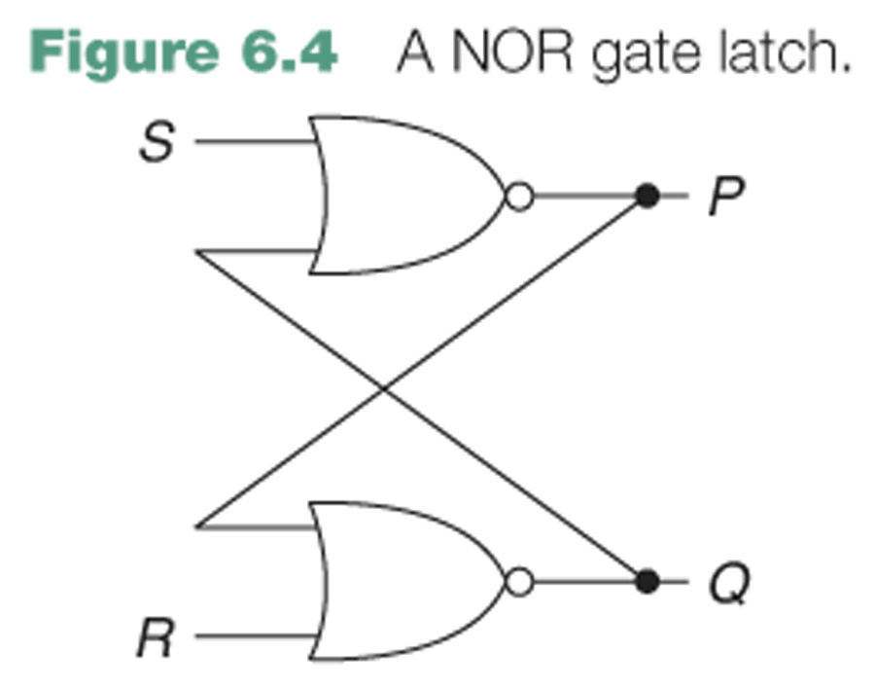
A latch is a binary storage device.
P = (S + Q)′
Q = (R + P)′

Slide 7
Flip-Flops - Next State Equations
RS-Flip Flops (Set-Reset)
  q* = S + R’q
D-Flip Flops (Delay)
  q* = D
T-Flip Flops (Toggle)
  q* = T + q
JK-Flip Flops (JK)
  q* = Jq’ + K’q
S
R
q
q’
D
q
q’
T
q
q’
J
K
q
q’
Clock

Slide 8
All Done?
Turn in all un-graded homework and lab exercises before 6:20pm today.
This includes the Visual Basic Lab.
10 Points per day for late papers beyond today.

Slide 9
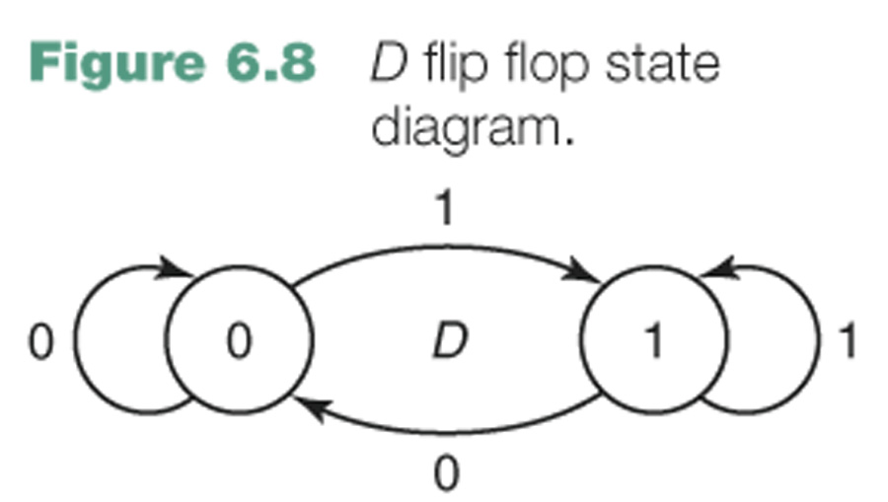
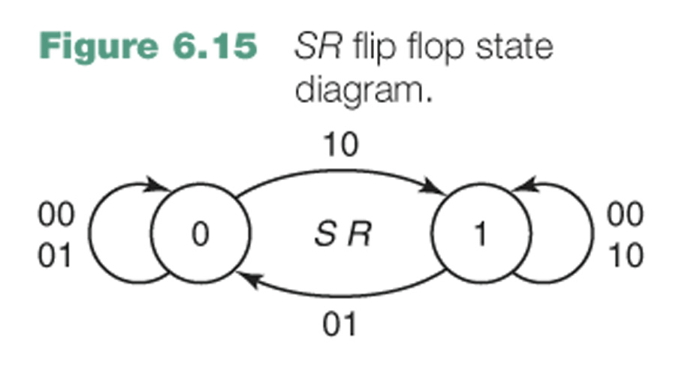
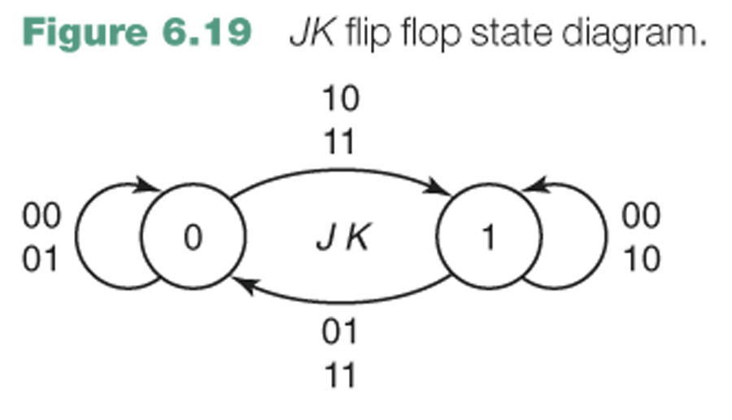
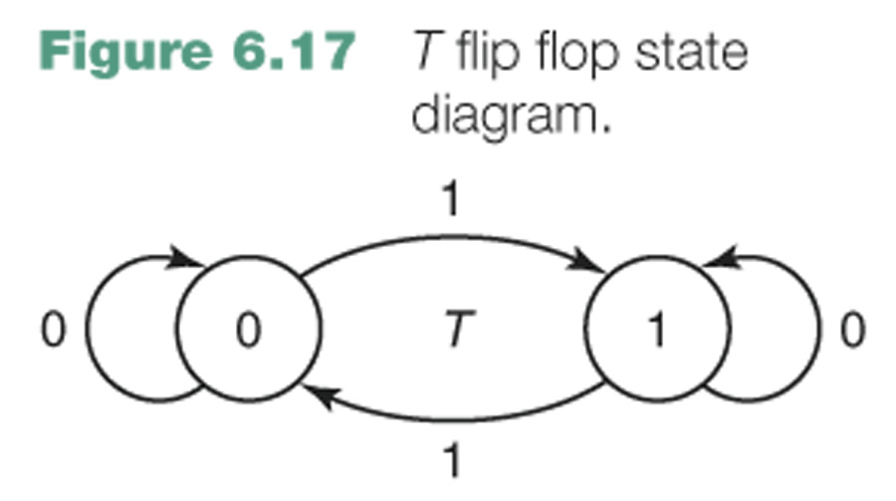

Slide 10
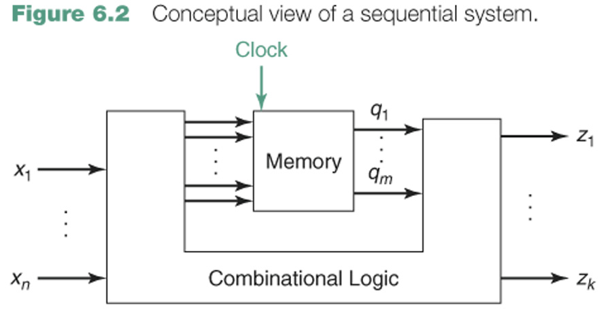

Slide 11
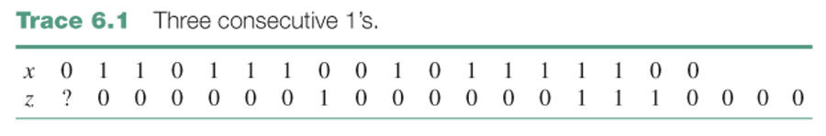
CE6. A system with one input x and one output z such that z = 1 at a clock time iff x is currently 1 and was also 1 at the previous two clock times.
State: what is stored in memory. It is stored in binary devices, but the information to be stored is not always naturally binary.
Timing trace: a set of values for the input and output (and sometimes the state or other variables of the system, as well) at consecutive clock times.

Slide 12
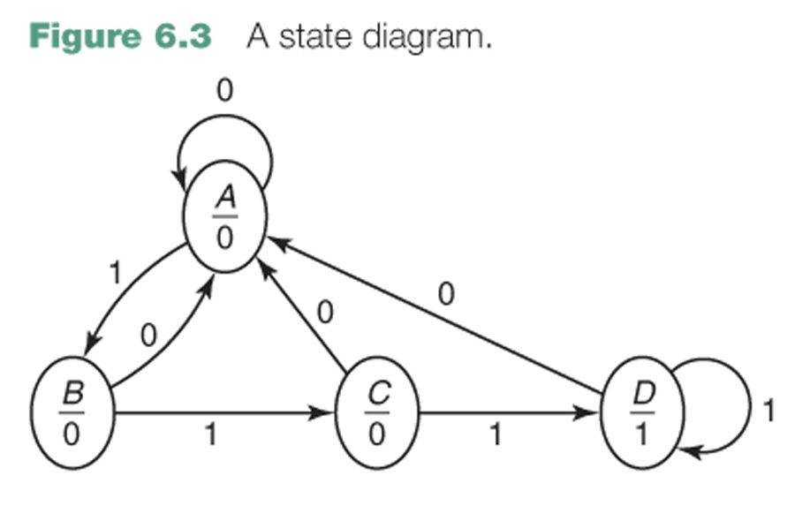
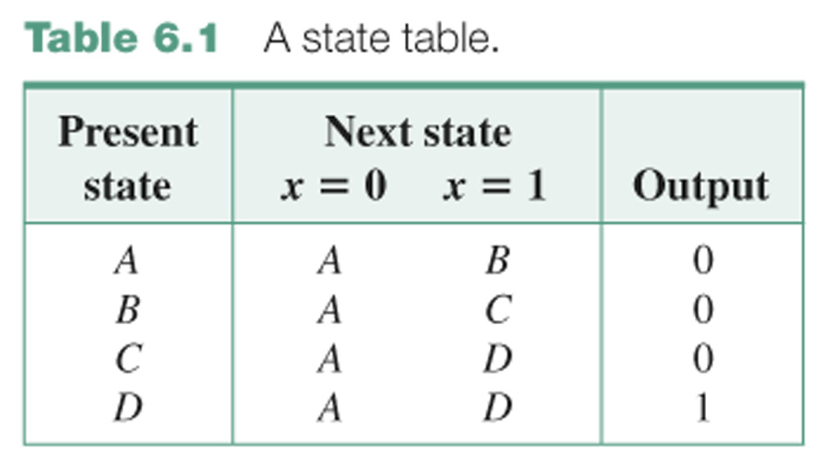
State table: shows for each input combination and each state, what the output is and what the next state is, that is, what is to be stored in memory after the next clock.
State diagram (or state graph): a graphical representation of the state table.

Slide 13
Lab Projects
Before Exam III
  Stepper Motor Controller
Before Exam IV
  Light Meter Interface

Slide 14
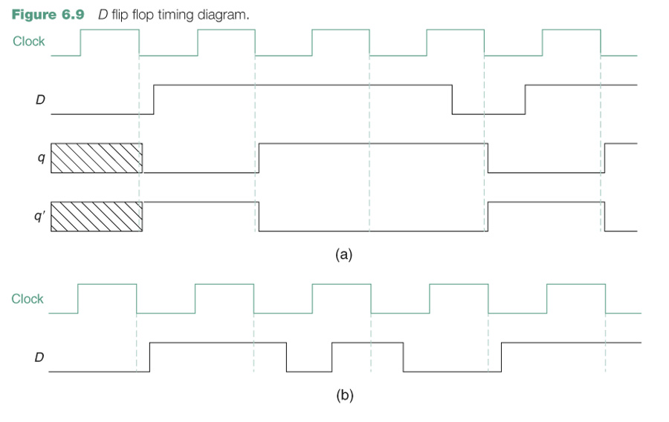

Slide 15
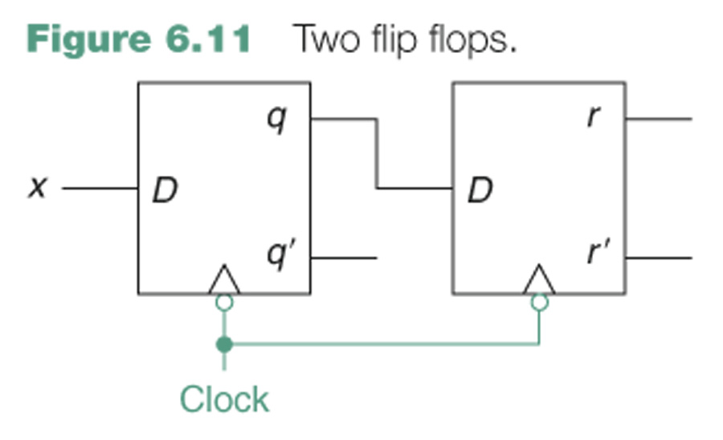
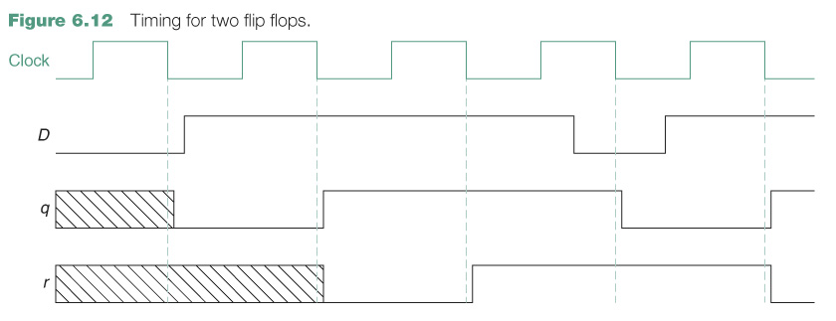

Slide 16
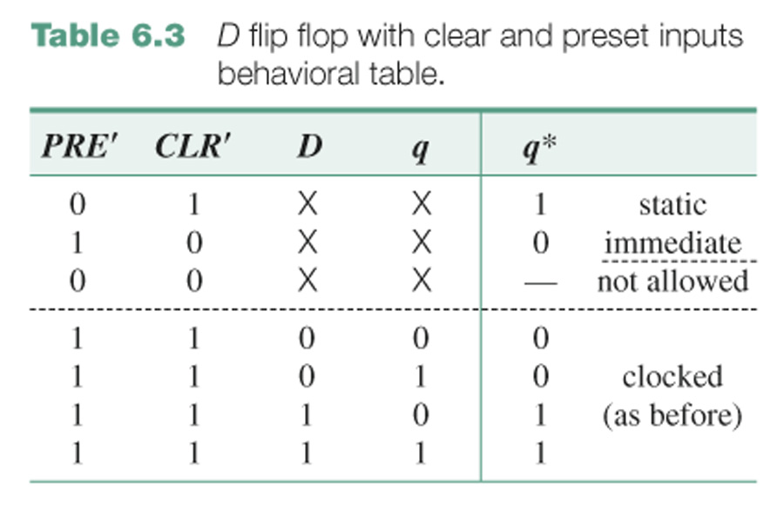
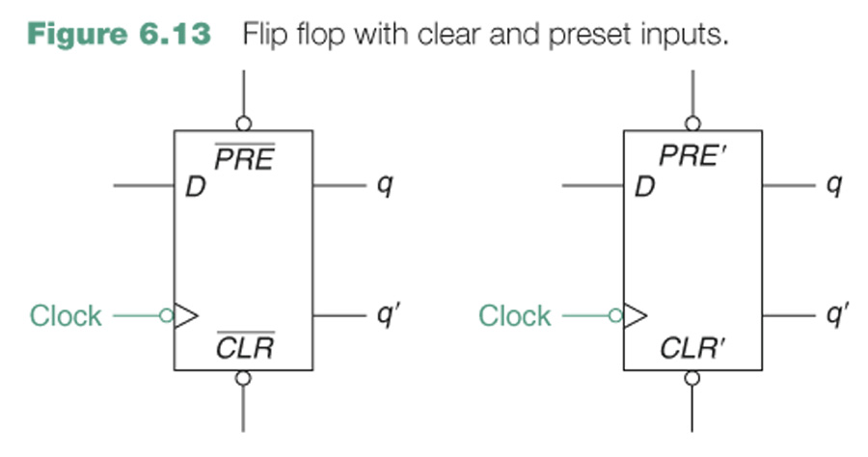

Slide 17
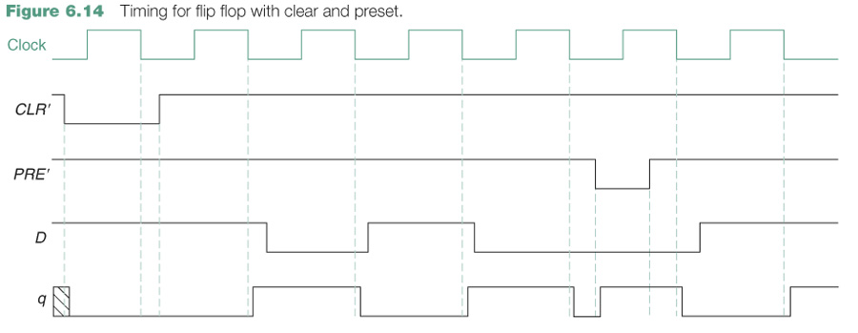

Slide 18
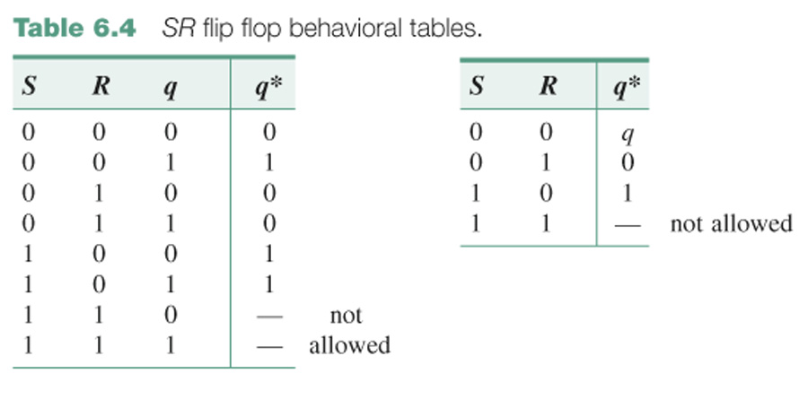
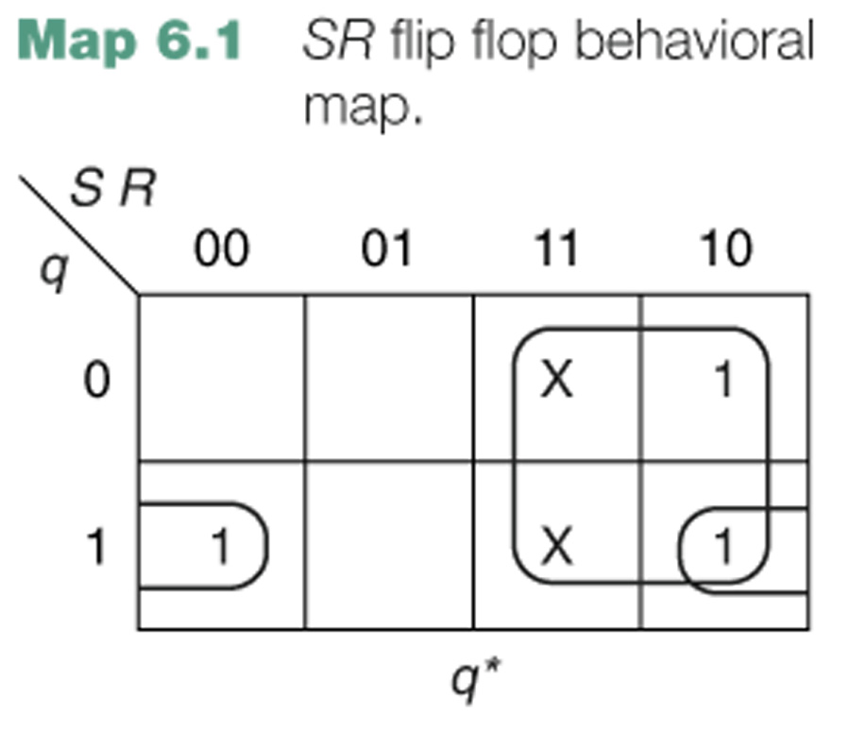
q* = S + R′q

Slide 19
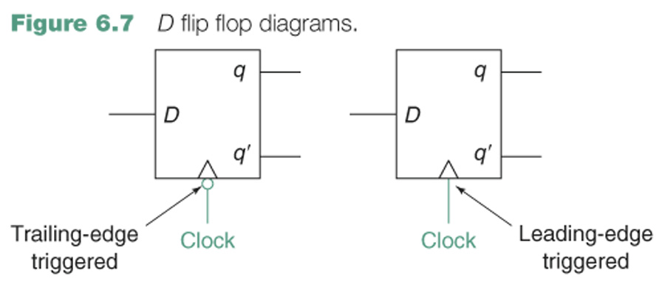
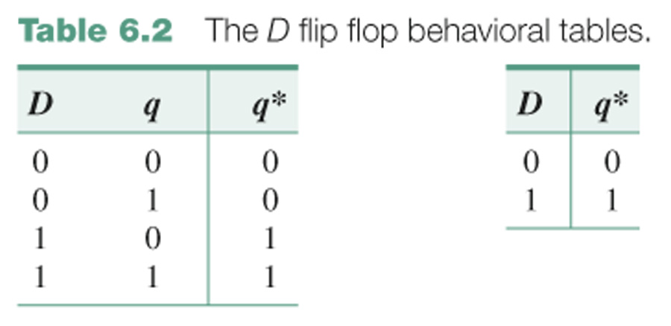

Slide 20
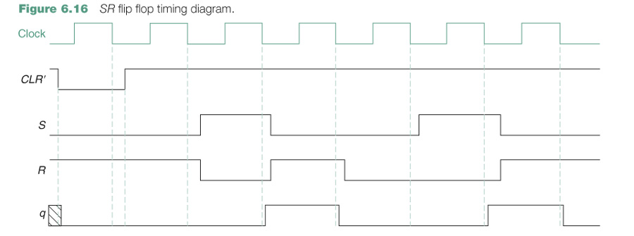

Slide 21
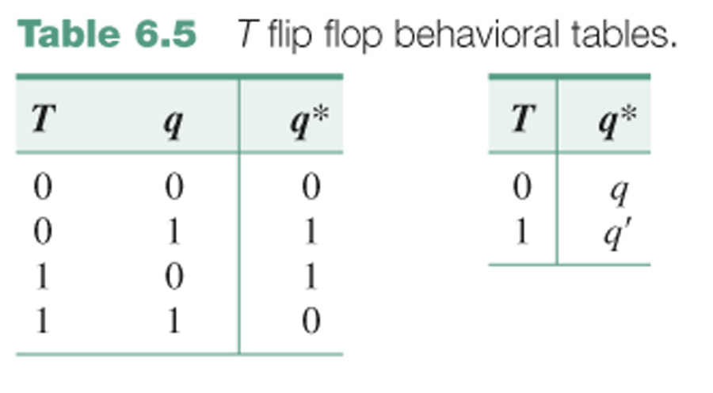
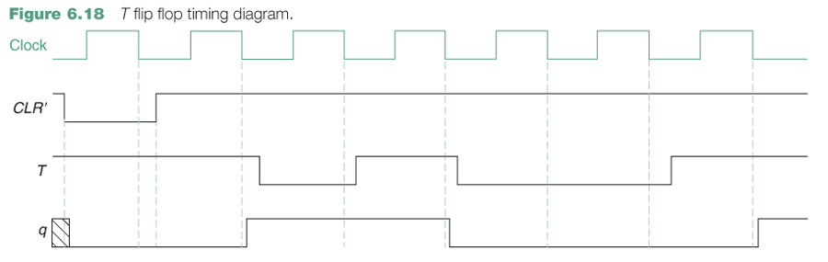
q* = T ⊕ q

Slide 22
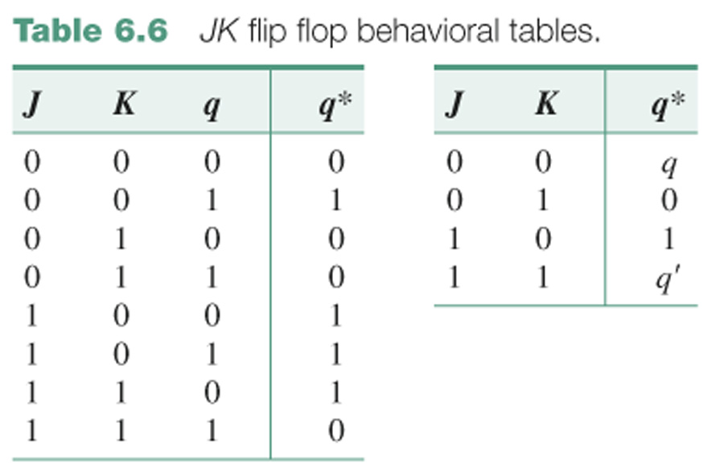
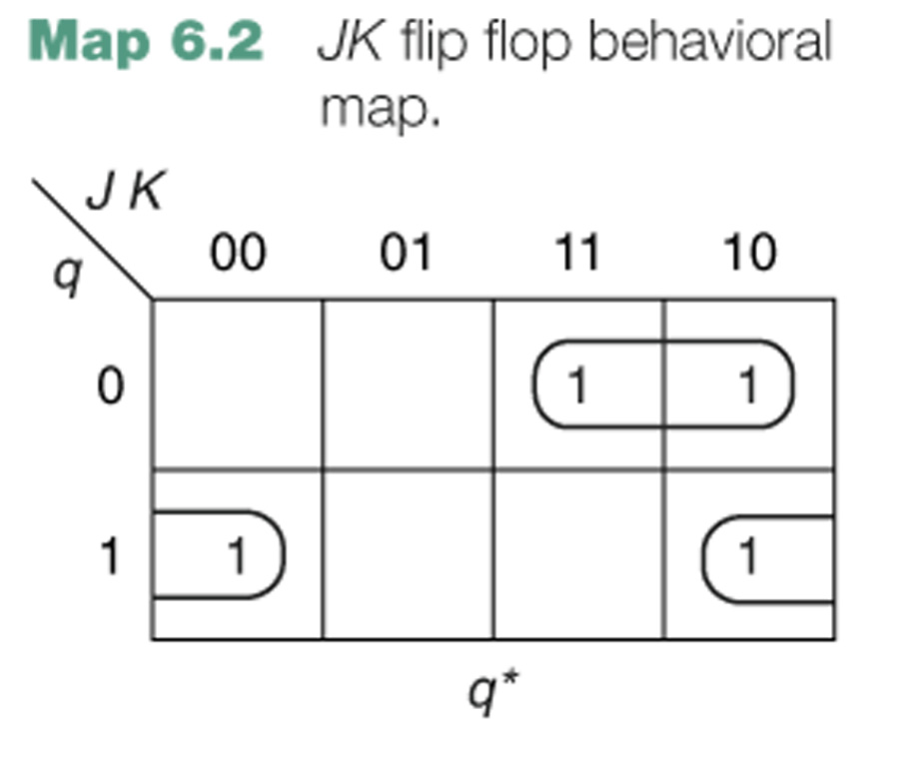
q* = Jq′ + K′q

Slide 23
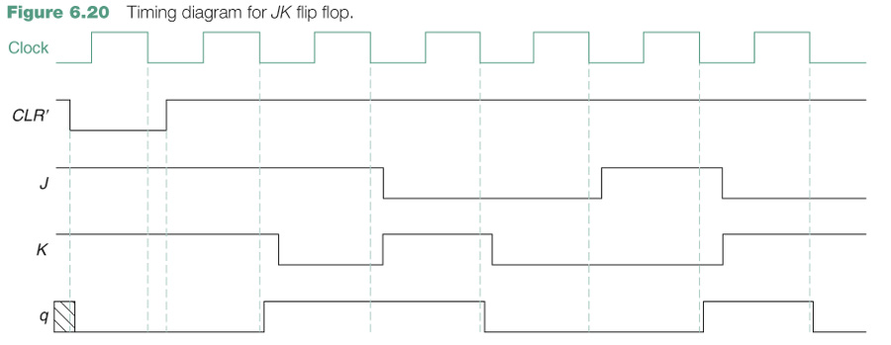

Slide 24
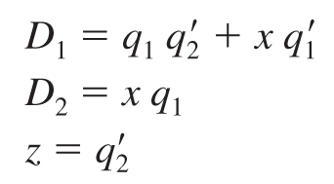

Slide 25
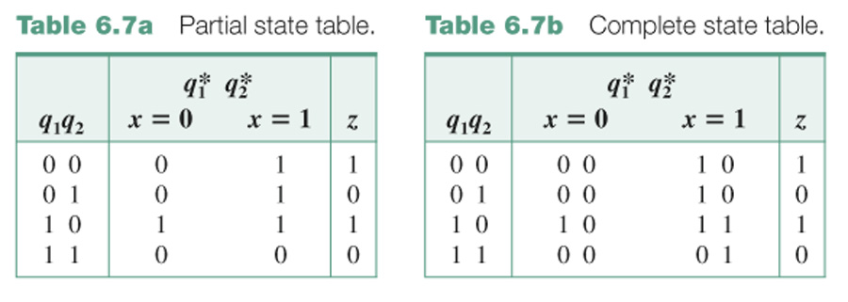
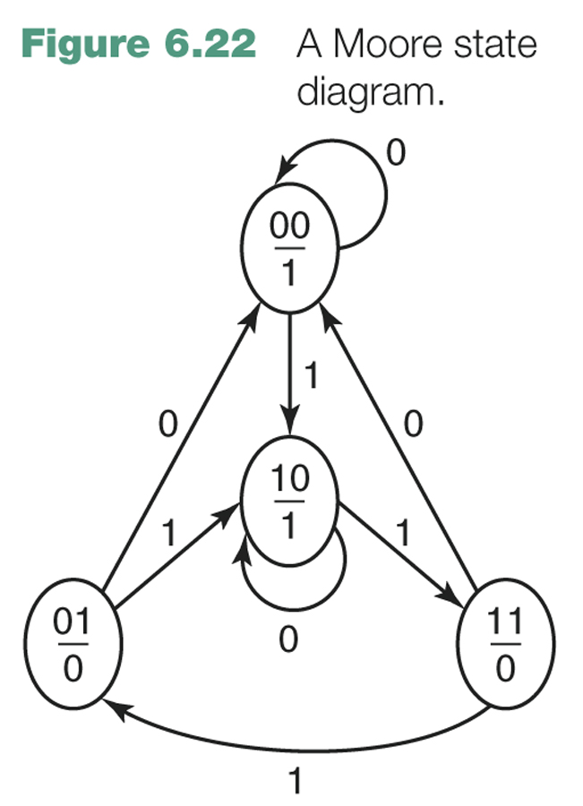

Slide 26
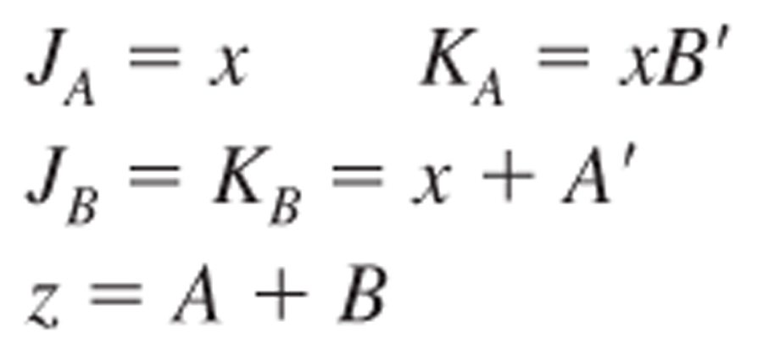

Slide 27
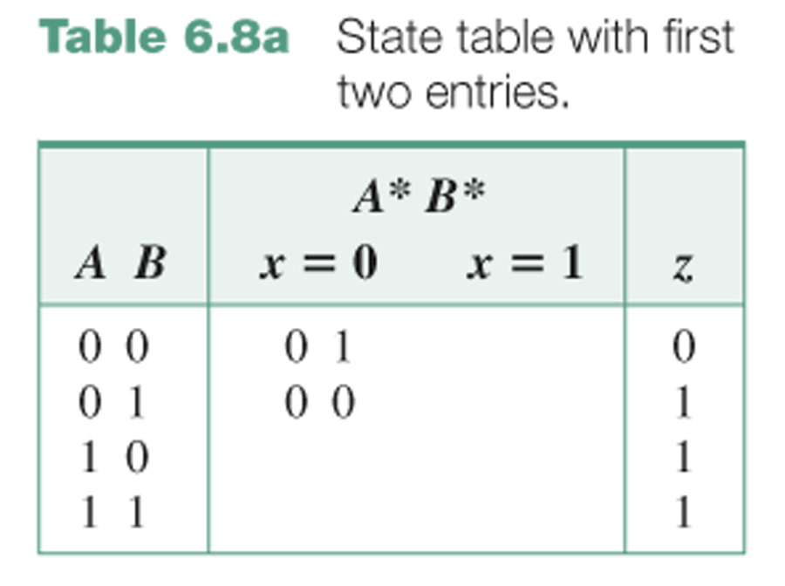
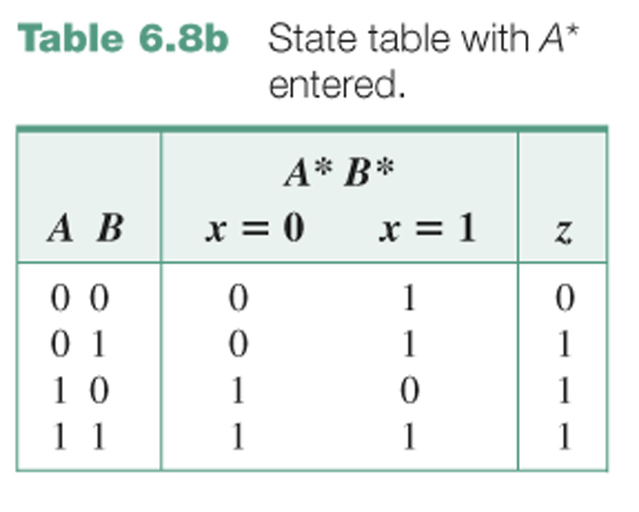
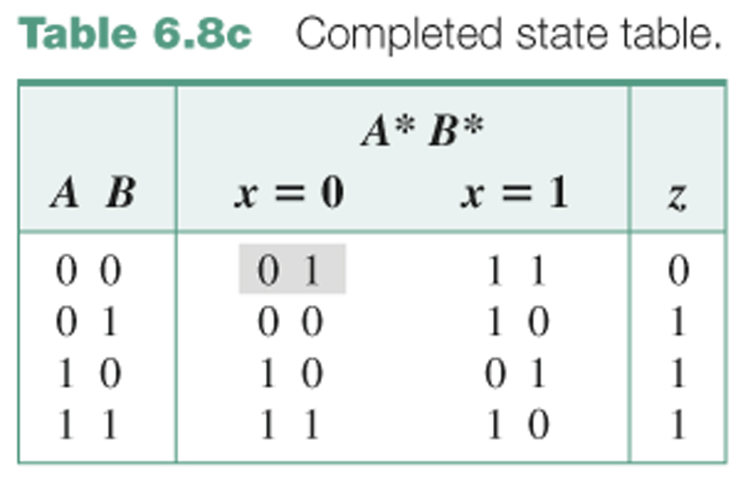
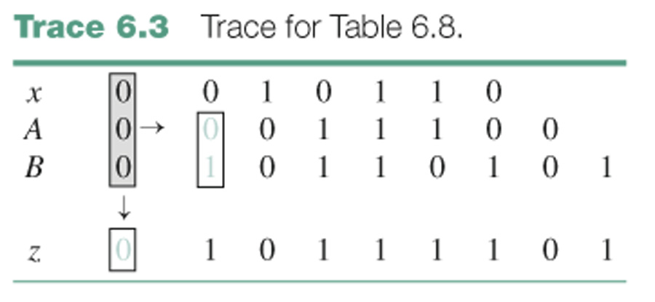

Slide 28
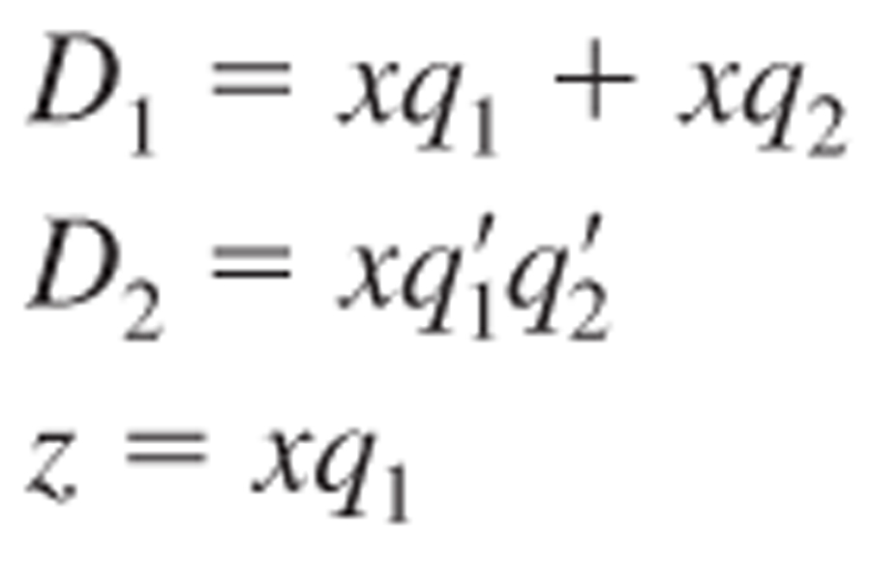

Slide 29
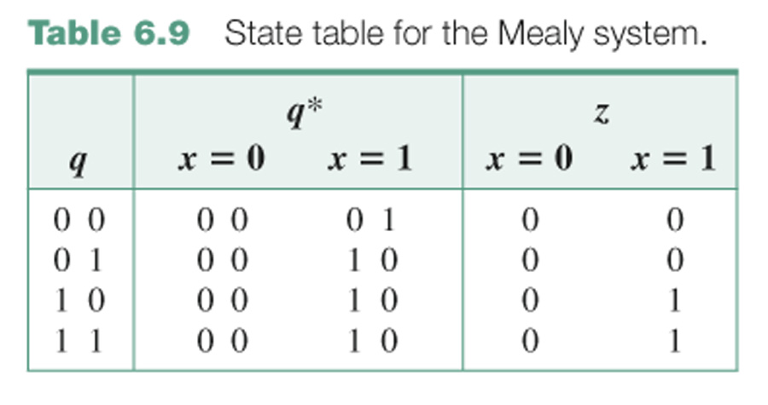
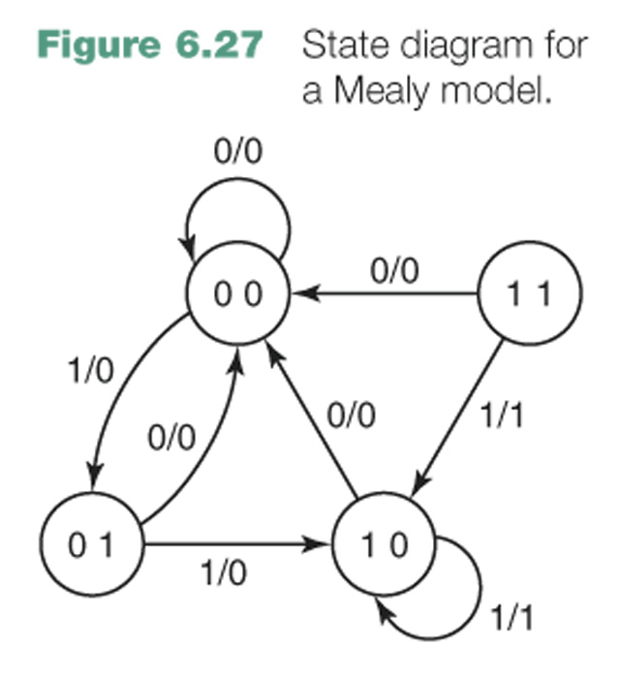

Slide 30
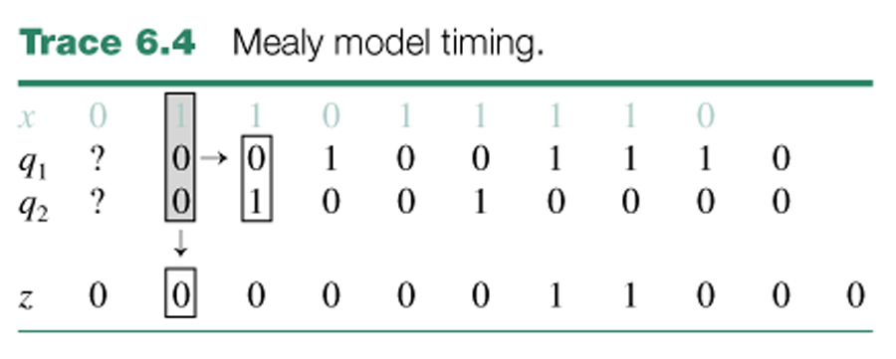
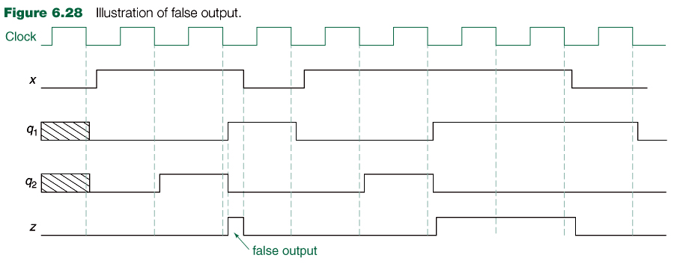

Slide 31
